Slide 1
Using Issues as a Context to Enhance Students’
Three-Dimensional Learning
Maia Binding, SEPUP, Lawrence Hall of Science
CSTA, Sacramento, October 13, 2017

Slide 2


Implementing New Standards
Curriculum – instructional materials
Classroom Assessment – formative & summative
Instruction – teaching tools

Slide 3
What is 3-D Learning?
Performance Expectations
Science and Engineering Practices
Disciplinary Core Ideas
Crosscutting Concepts
Links to Common Core

Slide 4

What is 3-D Learning?
The practices are the processes of building and using the core ideas to make sense of the natural and designed world, and the crosscutting concepts hold the discipline together.
Crosscutting Concepts
Core Ideas
Practices

Slide 5
Disciplinary Core Ideas (DCIs)
Physical Science
  Matter and its interactions
  Motion and stability: Forces and interactions
  Energy
  Waves and their applications in technologies for information transfer
Life Science
  From molecules to organisms: Structures and processes
  Ecosystems: Interactions, energy, and dynamics
  Heredity: Inheritance and variation of traits
  Biological evolution: Unity and diversity
Earth and Space Science
  Earth’s place in the universe
  Earth’s systems
  Earth and human activity
Engineering
  Engineering design

Slide 6
Science and Engineering Practices (SEPs)
Asking Questions and Defining Problems
Developing and Using Models
Planning and Carrying Out Investigations
Analyzing and Interpreting Data
Using Mathematics and Computational Thinking
Constructing Explanations and Designing Solutions
Engaging in Argument from Evidence
Obtaining, Evaluating, and Communicating Information

Slide 7
Crosscutting Concepts (CCCs)
Cause and Effect
Energy and Matter
Patterns
Scale, Proportion, and Quantity
Stability and Change
Structure and Function
Systems and System Models

Slide 8
Why Issues?
In order for students to develop a sustained attraction to science and for them to appreciate the many ways in which it is pertinent to their daily lives, classroom learning experiences in science need to connect with their own interests and experiences.
Next Generation Framework
National Research Council, 2011

Slide 9
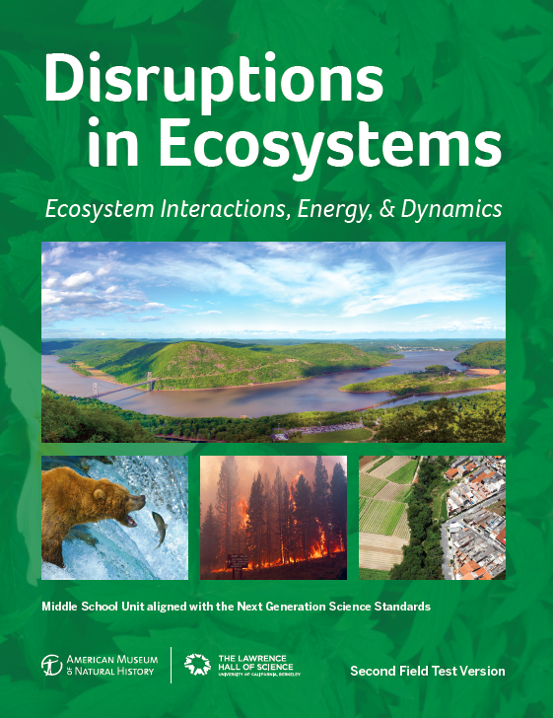
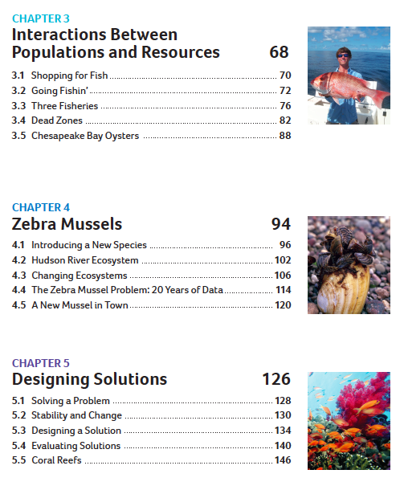
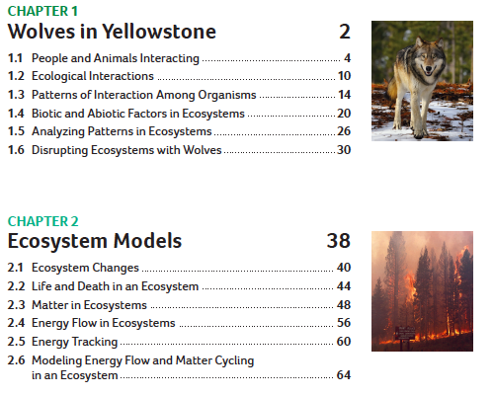

Slide 10
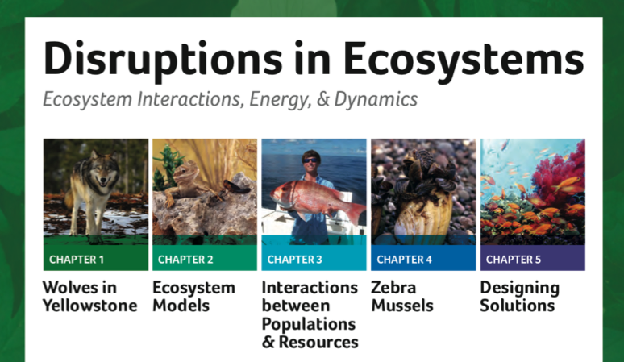
Big Ideas & Phenomena
Humans can affect the relationships among organisms in an environment.
Natural disasters can affect the transfer of energy and the cycling of matter in ecosystems.
The growth of organisms and populations are limited by the available resources.
The introduction of a new organism can affect the stability of an ecosystem.
Humans are using more resources, causing the need for solutions.

Slide 11
Example Activity
From a model middle school NGSS-aligned unit on Ecology
Overarching issue in chapter: invasive species (Zebra mussel in the Hudson River)
Final activity in the chapter
Evaluate activity in the 5E cycle

Slide 12
NGSS Alignment
DCIs | SEPs | CCCs
MS LS2.C.1 | Asking Questions | Stability and Change
MS LS2.A.1 | Analyzing and Interpreting Data | Cause and Effect
MS LS2.A.2 | Engaging in Argument from Evidence | Patterns
MS LS4.D.1
PEs: MS-LS2-4 and MS-LS2-1

Slide 13
Where did you see 3-D learning?
What could you do with your students throughout a unit/school year to make 3-D learning more explicit?

Slide 14
Contact Info
Maia Binding, SEPUP, Lawrence Hall of Science, mbinding@berkeley.edu
Thank you to NSF for funding this project, and AMNH for your partnership!
Presentation will be available on sepuplhs.org
Zebra mussel materials (graphing tool, readings) are on www.amnh.org/education/resources/rfl/web/riverecology
COMING SOON: Full unit (2nd Field Test Ed) to be posted on Achieve.org
Notes:
Achieve rated high quality if improved, improvements are being worked on and only involve minor tweaks/additions, scored 7 (need 8 points out of 9 to be high quality).

